Slide 1


Introduction to Service Fabric
dev up - 2016
Presented By: someone that still plays with cars
https://aka.ms/brent-servicefabric-intro
Notes:
Do introduction
Note: be entertaining! ;)

Slide 2
I always wanted to put a sign up on the road to Yale saying, ‘Beware: Deconstruction Ahead.’
Gloria Steinem – American Activist
Notes:
Obligatory quote from someone famous. This seemed as good as anything else.
We’re deconstructing monolith architectures with microservices…

Slide 3
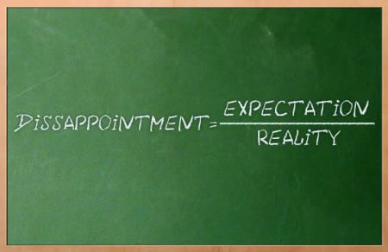
Setting Expectations
In-tro-duc-tion
Explain ‘what this is’
Both Code and Infrastructure
Together you get a clearer picture
DevOps
Configuration Through Code
Notes:
Introduction
The intent is to make you comfortable explaining to others at a high level what Service Fabric and Microservice Architectures are. If you are already actively working with Service Fabric, this likely isn’t the session for you.
Code and the Infrastructure
SvcFab is both the best and worst of IaaS and PaaS. It’s a powerful orchestration framework for microservices, but to leverage it fully, you also need to understand the infrastructure that supports it and how these two fit together.
DevOps
Service Fabric drags you kicking and screaming into the world of DevOps. You’ll need to understand the concept of configuration through code and how that impacts not just building your services, but also how they are deployed.
image from: https://thetechbench.wordpress.com/category/client-expectations/

Slide 4
Traditional application a.k.a Monolith
Compile-time contract validation
Local operations
Easier to reason about
Expensive to scale application
Hard to scale data access
Upgrades are a big deal
Notes:
For years we’ve been building n-tier applications. The influence of the “monolith” architectural style cannot be dismissed. This model, while this approach did solve some of the challenges of large scale solution development…
Communication contracts with compile time validation
Localized, internal communications
Discoverability… easy to understand, locate necessary functionality
But this approach does present some new challenges.
Monolithic solutions, while providing a separation of concerns, still results in the individual portions of an application being more tightly bound then their builders ever intended. This means that making significant changes is expensive and complicated. It also makes it more difficult to perform upgrades of individual portions of the system. It also presents challenges for scaling the solution if a limited number of aspects of the solution are the ones being overloaded.

Slide 5
Challenges of creating applications
Fragile environment
Webscale
Distributed teams
Frequent upgrades
Notes:
But the challenges don’t end there…
Monolithic solutions become fragile over time. They seem to breed dependencies between facets of the solution as well as the environment they are deployed in.
This type of architecture was born on-prem, in an “scale up” world. As such, they have difficulties trying to “scale out” when you try to turn them into externally consumable services.
When these solutions are not developed in a specific geography, but instead pulled together by teams spread around the globe, the dependencies are emphasized, and start to impede work getting done.
And as I’m sure some of you are well aware, these “technological terrors” are VERY difficult to upgrade frequently. Often there are detailed, complex plans required to perform upgrades and as a result you might update a solution only once or twice a year.

Slide 6

stateless
presentation services
Tiers of specific technologies
stateful
services
Single monolithic
database
stateless services
with
separate stores
Notes:
But solutions have evolved to try and address these issues. 10+ years ago, there was SOA which provided its own set of challenges. But recently a new standard has emerged, microservices.
By deconstructing the tiers of the monolithic application into smaller, more discrete services, we are able to decouple them, and allow us to manage and maintain them individually.

Slide 7
Microservices
Definition
Application created by connecting small, specialized services
Use bounded context that’s easily understandable
Use versioned interfaces for services
Service lifecycle owned by a small team
Benefits
Services are loosely coupled and independently deployable
Rapid development, innovation
Partitioned for scale and availability
Testability
Notes:
There are a significant amount of debate (mostly academic) about what exactly a microservice is. I’d caution you not to get too caught up in all this, and instead look at various approaches and find one that works best for you.
That said, there are some fairly common attributes:
An application is composed of multiple small, almost atomic services that each do one thing well
A service is specific to a bounded context (models of the business domain), providing a logical grouping of functionality
Services are clearly versioned.
The lifecycle of a service is owned by a small team, allowing them to remain agile and work independently of other services
The benefits will depend in large part on your implementation. But what you’re striving for is:
Loosely coupled, independent services that are easily deployable (few dependencies)
With such a small team and narrow functional scope, development cycles are short and agile. This increases the rate of development, delivery, and subsequently innovation
With this degree of granularity, it becomes much easier to validate the functionality of each service. And with versioning, you can ensure that backwards compatibility is maintained.
Notes
Bounded Context: http://martinfowler.com/bliki/BoundedContext.html

Slide 8
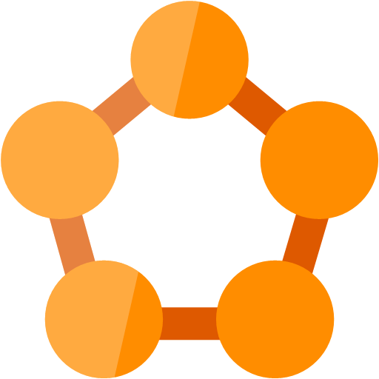
And from this was born Service fabric
An orchestration framework
A way to run, and manage microservices across a cluster of servers
Started Internally
Born inside Microsoft to build “cloud scale” solutions
Used by many of the most broadly used Azure and Office 365 services
And its FREE*!!!!
* the bits to create your clusters that is, you are still responsible for running them somewhere
Notes:
When you build microservice based solutions at scale, you start encountering some management challenges. Furthermore, you find as you build these types of solutions that there is a need for some common functionality and gets built time and time again. From these need, and Microsoft’s own experiences building cloud scale solutions was born Service Fabric.
Service Fabric is a orchestration frameworking for microservices. It provides a way to define the operating environment and run and manage the services across 10’s and even thousands of computers (either virtual or physical).
And while this started as a internal effort, to deliver solutions within Azure and Office 365, its now available to you *click* for FREE

Slide 9
Service Fabric
LifecycleMgmt
Independent Scaling
Independent Updates
Always On Availability
Resource Efficient
Stateless/
Stateful
Public Cloud
Other Clouds
Private cloud
Notes:
Next generation of PaaS on Azure
Elastic scale, OS updates, SF updates
Microservices platform for Windows and Linux
DevOps, rolling upgrades, etc.
Polycloud including on-premises
Programming models
Stateless Win32 apps written in any language (some feature not supported)
Reliable Services: Stateless & stateful (for hot data; gives low-latency reads)
OWIN/ASP.NET Core*
Service Fabric is free of charge
SDK: http://aka.ms/ServiceFabricSDK

Slide 10
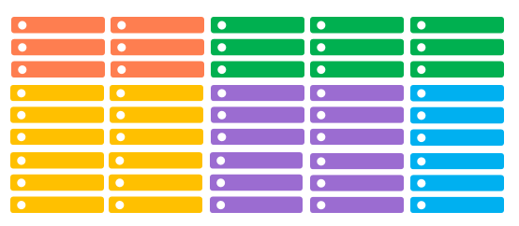
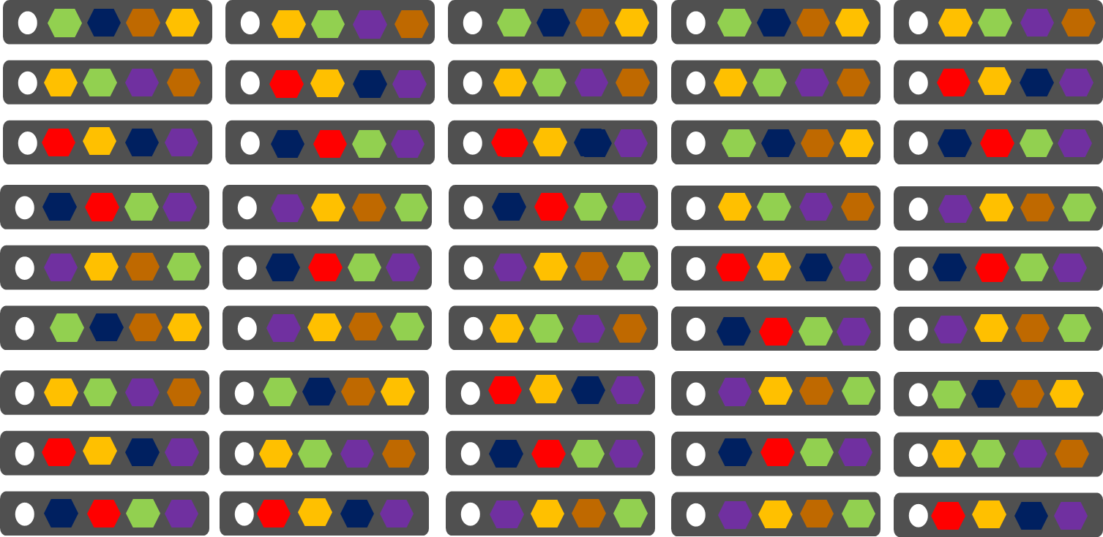
Conventional Services
Service Fabric
1 instance per VM (low density)
Uneven utilization
Slow scaling and failure recovery
Limited fault tolerance
Many services per VM (high density)
Even Utilization
Easier scaling of independent services
Tunable fast fault tolerance
Notes:
Now at this point, most introductions to service fabric would start discussing building services for Service Fabric. You’d see them deployed to a cluster and things would just magically work. But this isn’t one of those presentations. Instead, I’d like to take a few minutes to dispel some of the mystery around how this “microservice orchestration framework” differs from conventional approaches. And just as importantly, what makes up a “service fabric cluster”.
*click* Lets start with a conventional service deployment
Most of the time you’re going to deploy 1 copy of a server per host (usually a virtual machine). You’re also likely to have multiple hosts, with different capabilities… some with more RAM, some with more CPU, perhaps some with specialized hardware like GPUs. This creates an environment where utilization is uneven, some machines are under more load then others. It also limits the solutions ability to scale or be resilient to failures.
*click* The first thing service fabric does is provide a unified management plane across multiple hosts. Its these hosts (referred to as nodes) that comprise the cluster. It’s the visibility into these nodes that give the fabric the ability monitor the hosts, and manage the services to ensure their health.
*click* With this visibility, the fabric is able to distribute the services across the available nodes. And since the fabric is aware of the load on the nodes, it can place many services into the same node and adding additional copies of a service as you determine the need. It can even move them around if one node starts to experience problems.

Slide 11

Service Fabric Cluster
PC/VM #2
Service Fabric
Your code, etc.
PC/VM #3
Service Fabric
Your code, etc. (Port: 19080)
PC/VM #1
Your code, etc.
Service Fabric
PC/VM #4
Load Balancer
Your code, etc.
Service Fabric
Your code, etc.
PC/VM #5
Web Request (Port: 80/443/?)
Service Fabric
Your code, etc.
Notes:
Lets take a closer look at what comprises a cluster.
Box representing cloud
Contains Cluster (can contain 1000s of nodes)
Contains Nodes (@ has name)
Endpoints
HttpGateWay (19007), Cluster (tcp: 19000)?
Your “static” code/data/config
Load Balancer
Animate: start w/DC box
Enter some nodes (names)
Install OS/SF
Establish endpoints to create cluster
You code/data/config
Load Balancer
Client request → LB → to a node
---
<?xml version="1.0" encoding="utf-8"?>
<!--
WARNING WARNING WARNING WARNING WARNING WARNING WARNING WARNING WARNING WARNING WARNING
WARNING WARNING WARNING WARNING WARNING WARNING WARNING WARNING WARNING WARNING WARNING
WARNING WARNING WARNING WARNING WARNING WARNING WARNING WARNING WARNING WARNING WARNING
The settings used within this ClusterManifest are expressly for use only
within a developer single-box environment. Any use of these settings outside
of that environment are highly likely to produce incorrect, and misperforming
systems.
WARNING WARNING WARNING WARNING WARNING WARNING WARNING WARNING WARNING WARNING WARNING
WARNING WARNING WARNING WARNING WARNING WARNING WARNING WARNING WARNING WARNING WARNING
WARNING WARNING WARNING WARNING WARNING WARNING WARNING WARNING WARNING WARNING WARNING
-->
<ClusterManifest
xmlns:xsd="http://www.w3.org/2001/XMLSchema"
xmlns:xsi="http://www.w3.org/2001/XMLSchema-instance"
xmlns="http://schemas.microsoft.com/2011/01/fabric"
Name="ComputerName-Local-Cluster"
Version="1.0">
<NodeTypes>
<NodeType Name="NodeType1">
<Endpoints>
<ClientConnectionEndpoint Port="19000" />
<LeaseDriverEndpoint Port="19001" />
<ClusterConnectionEndpoint Port="19002" />
<HttpGatewayEndpoint Port="19007" Protocol="http" />
<ServiceConnectionEndpoint Port="19006" />
<ApplicationEndpoints StartPort="30001" EndPort="31000" />
</Endpoints>
</NodeType>
<NodeType Name="NodeType2">
<Endpoints>
<ClientConnectionEndpoint Port="19010" />
<LeaseDriverEndpoint Port="19011" />
<ClusterConnectionEndpoint Port="19012" />
<HttpGatewayEndpoint Port="19017" Protocol="http" />
<ServiceConnectionEndpoint Port="19016" />
<ApplicationEndpoints StartPort="31001" EndPort="32000" />
</Endpoints>
</NodeType>
<NodeType Name="NodeType3">
<Endpoints>
<ClientConnectionEndpoint Port="19020" />
<LeaseDriverEndpoint Port="19021" />
<ClusterConnectionEndpoint Port="19022" />
<HttpGatewayEndpoint Port="19027" Protocol="http" />
<ServiceConnectionEndpoint Port="19026" />
<ApplicationEndpoints StartPort="32001" EndPort="33000" />
</Endpoints>
</NodeType>
<NodeType Name="NodeType4">
<Endpoints>
<ClientConnectionEndpoint Port="19030" />
<LeaseDriverEndpoint Port="19031" />
<ClusterConnectionEndpoint Port="19032" />
<HttpGatewayEndpoint Port="19037" Protocol="http" />
<ServiceConnectionEndpoint Port="19036" />
<ApplicationEndpoints StartPort="33001" EndPort="34000" />
</Endpoints>
</NodeType>
<NodeType Name="NodeType5">
<Endpoints>
<ClientConnectionEndpoint Port="19040" />
<LeaseDriverEndpoint Port="19041" />
<ClusterConnectionEndpoint Port="19042" />
<HttpGatewayEndpoint Port="19047" Protocol="http" />
<ServiceConnectionEndpoint Port="19046" />
<ApplicationEndpoints StartPort="34001" EndPort="35000" />
</Endpoints>
</NodeType>
</NodeTypes>
<Infrastructure>
<WindowsServer IsScaleMin="true">
<NodeList>
<Node NodeName="Node.1" IPAddressOrFQDN="localhost" IsSeedNode="true" NodeTypeRef="NodeType1" FaultDomain="fd:/FD01" UpgradeDomain="UD1" />
<Node NodeName="Node.2" IPAddressOrFQDN="localhost" IsSeedNode="true" NodeTypeRef="NodeType2" FaultDomain="fd:/FD02" UpgradeDomain="UD2" />
<Node NodeName="Node.3" IPAddressOrFQDN="localhost" IsSeedNode="true" NodeTypeRef="NodeType3" FaultDomain="fd:/FD03" UpgradeDomain="UD3" />
<Node NodeName="Node.4" IPAddressOrFQDN="localhost" IsSeedNode="false" NodeTypeRef="NodeType4" FaultDomain="fd:/FD04" UpgradeDomain="UD1" />
<Node NodeName="Node.5" IPAddressOrFQDN="localhost" IsSeedNode="false" NodeTypeRef="NodeType5" FaultDomain="fd:/FD05" UpgradeDomain="UD2" />
</NodeList>
</WindowsServer>
</Infrastructure>
<FabricSettings>
<Section Name="Security">
<Parameter Name="ClusterCredentialType" Value="None" />
<Parameter Name="ServerAuthCredentialType" Value="None" />
</Section>
<Section Name="FailoverManager">
<!-- expected cluster size allows the placement to start when the cluster is started. This value should be less than total number of nodes
as without it the FailoverManager will not start the placement of the user services. This value should be 80% to 90% of the cluster size.
-->
<Parameter Name="ExpectedClusterSize" Value="4" />
<!-- The default target and min replica set sizes are 7 and 5. The below configuration is not required for cluster that have 7 or more nodes. -->
<Parameter Name="TargetReplicaSetSize" Value="5" />
<Parameter Name="MinReplicaSetSize" Value="3" />
<Parameter Name="ReconfigurationTimeLimit" Value="20" />
<Parameter Name="BuildReplicaTimeLimit" Value="20" />
<Parameter Name="CreateInstanceTimeLimit" Value="20" />
<Parameter Name="PlacementTimeLimit" Value="20" />
</Section>
<Section Name="ReconfigurationAgent">
<Parameter Name="ServiceApiHealthDuration" Value="20" />
<Parameter Name="ServiceReconfigurationApiHealthDuration" Value="20" />
<Parameter Name="LocalHealthReportingTimerInterval" Value="5" />
<Parameter Name="IsDeactivationInfoEnabled" Value="true" />
</Section>
<Section Name="ClusterManager">
<!-- The default target and min replica set sizes are 7 and 5. The below configuration is not required for cluster that have 7 or more nodes. -->
<Parameter Name="TargetReplicaSetSize" Value="5" />
<Parameter Name="MinReplicaSetSize" Value="3" />
<Parameter Name="UpgradeStatusPollInterval" Value="5" />
<Parameter Name="UpgradeHealthCheckInterval" Value="5" />
<Parameter Name="FabricUpgradeHealthCheckInterval" Value="5" />
</Section>
<Section Name="NamingService">
<!-- The default target and min replica set sizes are 7 and 5. The below configuration is not required for cluster that have 7 or more nodes. -->
<Parameter Name="TargetReplicaSetSize" Value="5" />
<Parameter Name="MinReplicaSetSize" Value="3" />
</Section>
<Section Name="Management">
<Parameter Name="ImageStoreConnectionString" Value="file:C:\SfDevCluster\Data\ImageStore" />
<Parameter Name="ImageCachingEnabled" Value="false" />
</Section>
<Section Name="Hosting">
<Parameter Name="EndpointProviderEnabled" Value="true" />
<Parameter Name="RunAsPolicyEnabled" Value="true" />
<Parameter Name="DeactivationScanInterval" Value="60" />
<Parameter Name="DeactivationGraceInterval" Value="10" />
<Parameter Name="EnableProcessDebugging" Value="true" />
<Parameter Name="ServiceTypeRegistrationTimeout" Value="20" />
<Parameter Name="CacheCleanupScanInterval" Value="300" />
</Section>
<Section Name="HttpGateway">
<Parameter Name="IsEnabled" Value="true" />
</Section>
<Section Name="PlacementAndLoadBalancing">
<!-- balance the load on the cluster every 5 minutes. -->
<Parameter Name="MinLoadBalancingInterval" Value="300" />
</Section>
<Section Name="Federation">
<Parameter Name="NodeIdGeneratorVersion" Value="V3" />
</Section>
<Section Name="Trace/Etw">
<Parameter Name="Level" Value="4" />
</Section>
<!-- Configure the DCA to cleanup the log folder only. The collection of the logs, performance counters and crashdumps is not performed on the local machine. -->
<Section Name="Diagnostics">
<Parameter Name="ProducerInstances" Value="ServiceFabricEtlFile, ServiceFabricPerfCtrFolder" />
<Parameter Name="MaxDiskQuotaInMB" Value="10240" />
</Section>
<Section Name="ServiceFabricEtlFile">
<Parameter Name="ProducerType" Value="EtlFileProducer" />
<Parameter Name="IsEnabled" Value="true" />
<Parameter Name="EtlReadIntervalInMinutes" Value=" 5" />
<Parameter Name="DataDeletionAgeInDays" Value="3" />
</Section>
<Section Name="ServiceFabricPerfCtrFolder">
<Parameter Name="ProducerType" Value="FolderProducer" />
<Parameter Name="IsEnabled" Value="true" />
<Parameter Name="FolderType" Value="WindowsFabricPerformanceCounters" />
<Parameter Name="DataDeletionAgeInDays" Value="3" />
</Section>
<Section Name="TransactionalReplicator">
<Parameter Name="MaxStreamSizeInMB" Value="64" />
</Section>
</FabricSettings>
</ClusterManifest>

Slide 12
Lets take a look…
The Portal
Content © Microsoft
Notes:
So lets take a look at two different clusters
Local machine (with SDK)
pull up the local copy of the portal http://localhost:19080
Services (only addressable from within the cluster)
Cluster Services
Failover Manager: deals with nodes being added or removed from the cluster. Redistributing services as needed
Cluster Manager: works with the failover manager to place services on nodes
Naming Service: allows for discovery of services and their endpoints
Node distribution: fault and update domains
Process threads
Azure Hosted:
Resource group – examine resources
Portal - http://devupsfmgmnt.centralus.cloudapp.azure.com:19080
Two services that don’t exist locally
Image Store Service: the application/service store. register and store packages. Doesn’t appear on the local cluster since its on the local disk
Upgrade Service: maintains the cluster svcfab bits

Slide 13
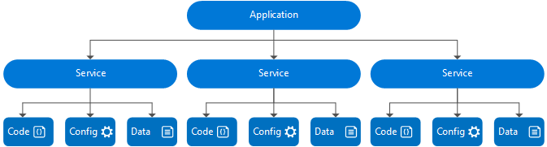
Application composition
Notes:
*click* An application:
Is a logical grouping of services
Is an upgrade unit. An upgrade targets an application instance
Can have different versions of the same application type side-by-side
instances of the same type get their own processes
*click* A service:
Is a logical grouping of partitions (and replicas/instances)
Is upgraded as part of an application upgrade (but you determine which ones to upgrade)
Can not have different versions of the same service type within an application
instances of the same type share a process
Image from: https://azure.microsoft.com/en-us/documentation/articles/service-fabric-application-model/

Slide 14
An Application
Declarative template (class) for creating an application (object)
Based on a set of service types
Used for packaging, deployment, and versioning
Application Type A
Service Type 1
Service Type 2
Service Type 3
Notes:
An application is service fabric a combination of services. It is defined declaratively using an xml based “application manifest” file. This is much like a traditional class definition in that manifest defines the application type. But it isn’t until its deployed to a fabric cluster that you have a running version. It’s the deployment of the application that instantiates an object from the class described in the manifest.
This is a largely logical construct. Allowing you to compose services together and assisting in the packaging of the services for deployment, as well as helping managing versioning. You can even

Slide 15
A Service
Services types are composed of code/config/data packages
Code packages define an entry point (dll or exe)
Config packages define service specific config information
Data packages define static resources (eg. images)
Packages can be independently versioned
<ServiceManifest Name="QueueService" Version="1.0">
<ServiceTypes>
<StatefulServiceType ServiceTypeName="QueueServiceType" HasPersistedState="true" />
</ServiceTypes>
<CodePackage Name="Code" Version="1.0">
<EntryPoint>
<ExeHost>
<Program>ServiceHost.exe</Program>
</ExeHost>
</EntryPoint>
</CodePackage>
<ConfigPackage Name="Config" Version="1.0" />
<DataPackage Name="Data" Version="1.0" />
</ServiceManifest>
Service Type 1
Code
Config
Data
Notes:
A service, much like the application is defined in a service manifest. A service is comprised of three packages:
Code – executable code that is what service fabric will “run”
Config – service specific configuration details (connection strings, endpoint configuration, etc…
Data – static resources needed by the service (images, data files)
Each of these packages can be independently versioned. This allows you to issue updates to just one while leaving the others alone.

Slide 16





Defining applications and services
Code
Config
Application Type
Application
Package
Counter
Service type
Unit of
Lifetime
Versioning
Isolation
Counter WebApp type
Counter
Service
Pkg
Counter
WebApp
Pkg
Notes:
So lets review..
*click* We have services that are composed of items like code and configuration details.
*click* These components are packaged together to form the service package.
*click* That service is possibly combined with others, forming an application. And subsequently deployed to the cluster. That application package gives us a way to manage those services throughout their lifetime.

Slide 17
Service Fabric service “templates”
Stateless microservice
Has either no state or it can be retrieved from an external store
There can be N instances
e.g. web frontends, protocol gateways, Azure Cloud Services etc.
Stateful microservice
Maintain hard, authoritative state
N consistent copies achieved through replication and local persistence
e.g. database, documents, workflow, user profile, shopping cart etc.
Guest Executables
Allows you to run non-service fabric services
Notes:
Each Service Fabric service is based on a “template” service type.
*click* Stateless services are ones that do not contain any internally stored state. Either because they don’t have any state, or they have pushed it out to an external store. Stateless services, because they lack the overhead of state, can be easily moved around or scaled up and down as needed. They are great for web based front ends or simple processing.
*click* Stateful services maintain data, or state within them. They have mechanism unique to Service fabric to ensure that this state is synchronized across instances of the service (referred to as replicates). The state can also be persisted internally in memory, on the disk of the node that’s running the service, or even pushed out to an external store. Stateful services also have feature “partitions” which is a way of spreading the load against the state out. Given them a unique capacity to scale out.
*click* And finally we have guest executables. This type of service allows you to run something that’s not a native service fabric service or application. It could be a node application, perhaps something with OWIN, or maybe even a docker container. The choice is yours. Service Fabric will just attempt to keep as many copies of this “service” running as you tell it.
As a final note, if you think back to when were looking at the Service Fabric cluster, you remember those “system” services. They were created using these same service templates.

Slide 18


Stateful Services & Reliable Collections
IReliableDictionary<K,V>
IReliableQueue<T>
Data is replicated between nodes/instance for high availability
Transactional, across collections
Multiple transaction isolation levels
Data can be backed up and restored
Flexible persistence model
Notes:
Stateful services maintain state using a reliable collection. The dictionary and the queue. The dictionary provides a key/value pair mechanism for storing and retrieving data. The queue provides a simple FIFO mechanism. These collections are hosted within a stateful service which acts as the interface for interacting with it. The portioning we mentioned for stateful services in mirrored in the reliable collection.
While these collections are a natural evolution of their .Net cousins, within service fabric, they gain some new and unique functionality..
*click* Reliable collections replicate their state to secondary instances of the service. For each service, you get one primary, and multiple secondary instance. The fabric keeps track of which one is the primary on your behalf so clients interacting with the service don’t have too.
*click* Reliable collections support transaction control. This scope extends across collections and operations. This includes being able read from within a transaction and getting results based on the pending state.
*click* With multiple levels of isolation within a transaction, allowing the locking (or not) of data that is being modified.
*click* And for .Net Developers, these collections support LINQ queries. ☺
*click* The data contained inside of a collection can be stored in memory (great for caching solutions), placed on the local disk of the host node, or pushed to an external state store as needed.
Notes:
https://azure.microsoft.com/en-us/documentation/articles/service-fabric-reliable-services-quick-start/

Slide 19
A couple service … restrictions
Classic ASP is out, Service Fabric and IIS don’t play well together
OWIN
Web Sockets
Kestrel
Katana
Any object going into a reliable collection must be serializable
Notes:
Now running inside Service Fabric comes with some restrictions…
First off, IIS and Service Fabric use different activation models. As such, they are not compatible. You can’t host a “classic” ASP.NET application in Service Fabric. It needs to be something that can be self hosted. Examples include…
Also, any object you’re placing into a reliable collection must be serializable.
There are other limits like being congnizant of the size of a deployment package… And as more projects adopt service fabric, this list does increase. So as you investigate it for your own needs, keep a close eye out for limits.

Slide 20
Lets take a look…
Wordcount Demo
Content © Microsoft
Notes:
Wordcount demo app (local: http://localhost:<port>/wordcount/)
Show app in visual studio
Solution Explorer & Manifests
Program.cs entry point, registering service type
Service inheritance
Build and Deploy Locally
Show deployed application/service constructs via portal

Slide 21
Publication and Deployment
Publish Package to the cluster
Package the application and service(s), this includes code, config, and data packages
Copy the package to the cluster (System:Image Store Service)
Register the application and service types
Reads and verifies the uploaded package
Processes the contents and copies to internal locations within the cluster
Stored with the application type, and version
Deploy instance of the application
Selects cluster nodes to receive services
Instantiates copies of each “default” application services
Notes:
So you’ve built your first service fabric application. Now you want to run it…. Now you can just press F5 in visual studio and point it to your remove cluster. It works fine. You can even run the powershell script that the Visual Studio scaffolding includes for you. But what do these things do? Lets look at this…
*click* The first step is to package up the application and copy that to the cluster. The package will include the manifests that describe the application and services, any environment specific parameter files, as well as the appropriate code, config, and data packages for each service. This “package” (I use the term loosely), is then copied to the service fabric cluster’s application store. This is one of this fabric cluster “system services” and keeps track of all the packages for each application/version that has been published to the cluster.
*click* Once the package has been copied to the cluster, you then have to register the application and service types. You can do this manually, and in some cases this may be what you want to do. But this option can also leverage the manifest files that were included in the package. When you register the application, it will verify that the package is valid (all the necessary items are there), and then processes its contents… during processing the various bits are copied around to the cluster nodes. It also registers the application and service types and versions.
*click* With the application and service registered, we’re not ready to stand up copies. The fabric, using the registered application type determines what services is comprises and then starts copies of those on each node in the cluster that they will run on. This process of activating the application/services also determines the process isolation boundary for the services. But that’s a more advanced topic for another day. ☺
Notes:
Deploy and remove applications: https://azure.microsoft.com/en-us/documentation/articles/service-fabric-deploy-remove-applications/

Slide 22
Service Placement
Fault and Upgrade Domains
Fault Domains -> Areas of Independent, Uncorrelated Failures: Power Sources, etc
Upgrade Domains -> No Downtime Rolling Upgrades
Placement Constraints
Tag nodes with properties and values
Select specific workloads for certain nodes, ex: (HasGPU == True)
Node Capacity
Define the resources (metrics) that each node has available
Define the minimum/default resource requirements for a service
Use default or customer metric with variable weights
Notes:
During deployment/instantiation, we start to see the orchestration functionality of Service Fabric come into play. It will inspect the requirements for each instance of each service, and the capabilities and capacity of the nodes in the cluster. This process can be broken down into two main categories… placement and load balancing.
Lets start by looking at service placement. Once we’ve crafted our application and services, the next step is to course to deploy them to the Service Fabric cluster. This is where the power of the “orchestration” part of Service Fabric really starts to show up.
*click* When deploying services, something needs to be “datacenter aware”, or have an understanding underlying hardware topology of the cluster. This understanding helps ensure that the instances of a service are spread across what we refer to as fault and upgrade domains. A fault domain can be thought of as a server rack. An upgrade domain is a logical groups of the nodes for (as the name implies) upgrade purposes. A host OS update is a common scenario. To ensure HA, Service Fabric needs to be ware of these constructs so that it can distribute the instances of a service across these constructs so that no single failure or underlying upgrade can take all the instances offline at the same time.
*click* Next, you may want to place the services on specific nodes. We discussed earlier that the cluster can be composed of different node types with different properties. Placement constraints are how you designate which nodes within the cluster a service can be hosted. Placement Properties are defined for each of the node types, and the service then defines the placement constraints that apply to it.
*click* Service Fabric features a rich resource governor/balancer. You want to find the proper balance of density for your services, not leaving any node over or under utilized. With this model, you can define the resources for a specific node has to offer. Then when services are placed on the node, we track how much of those resources (both at placement and at runtime) we can monitor the utilization of the node and will move service instance as needed.
Notes:
Service Orchestration with Service Fabric: https://channel9.msdn.com/Events/Ignite/2015/BRK3485

Slide 23

Cluster Resource Management
Monitors the state of the cluster
State of all nodes/services
Where services are deployed
Current resource consumption/utilization levels
Makes necessary changes
Placement
Constraint Checks
Balancing*
Coordinates activities
Works with other services like the Failover Manager to ensure cluster health
* Be aware of movement costs
Notes:
If you think back to our look at the cluster… and namely those system services, you may recall a mention of the Cluster Resource Management service. This service is the brain that gives Service Fabric is orchestration capabilities. It reacts on placement constraints, and the runtime metrics to help keep the cluster and all its services healthy. In fact, when you define the cluster, node types/capacity, and placement properties… you’re describing these to the resource management service.
It does a lot, but for simplicity, lets thing of it as having three core functions.
*click* First off, it monitors the state of the cluster. What’s going on with the nodes and services… where things have been deployed, and current consumption levels. It does this at configurable intervals based on various timers which can be set when you are defining the cluster (another advanced topic for another day).
*click* I then determines what changes are necessary. This could be something simple like placing a new instance of a service on a particular node, checking resource constraints and rebalancing the distribution of services. Or perhaps something larger such as healing a service after a failure.
*click* Finally, its coordinating these actions with other services like the Failover Manager to maintain overall cluster health.
One little footnote to all this. See that astrix on “balancing” there in the middle. Moving services should not be done lightly. It does come with a cost. Depending on the size of the service, and the amount of state it may contain… moving something could take seconds, or minutes. And during that time, well… unexpected things can happen. Depending on how you have built your service. So be aware, be prepared.
Notes:
Introduction to the Resource Manager: https://azure.microsoft.com/en-us/documentation/articles/service-fabric-cluster-resource-manager-introduction/
https://azure.microsoft.com/en-us/documentation/articles/service-fabric-cluster-resource-manager-architecture/
Metrics and Load: https://azure.microsoft.com/en-us/documentation/articles/service-fabric-cluster-resource-manager-metrics/
Balancing Cluster: https://azure.microsoft.com/en-us/documentation/articles/service-fabric-cluster-resource-manager-balancing/
Image Credit: Tron, Copyright Walt Disney Production, 1982

Slide 24
Application/Service Upgrades
Rolls across upgrade domains
In stages, one domain at a time
Each service should compatible one version up and down
Code changes impact the application hosting process (impacting other services)
Multiple Upgrade Types
Monitored: health of each upgrade domain checked before proceeding
Unmonitored Auto: on upgrade domain at a time, no health check
Unmonitored Manual: lets administrator upgrade one domain at a time
Service Versioning
Keep multiple versions published to make rollbacks easier
Same service, same cluster, different versions
Notes:
Ok, with that picture in your head (hopefully nobody has Tron nightmares tonight), lets move on to what happens when we have to deploy an update to a service that’s already running.
*click* the first principle of an upgrade in the service fabric is that they are done across upgrade domains (also referred to as update domains). One domain will be upgraded before you move on to the next. This of course requires the service to be compatible one version up and one down to ensure that calling clients don’t break. But more on that in a moment. Upgrade will be performed in a rolling fashion across the cluster, one upgrade domain at a time. And an important note here is that if you deploy code changes, and there’s more than one service in the application, you may see all the services on a particular node torn down and rebuilt at the same time. This is because all the services of a version of an application on the same service fabric node are managed by a host process. When doing a code upgrade, this host process may be torn down and restarted. This is due to the way Service Fabric handles activation and isolation. But another day…
*click* When performing an upgrade, you have three options to choose from. The default, Monitored, upgrades one domain and checks to make sure its healthy before moving on to the next automatically. Unmonitored Auto will do an automatic rolling upgrade, but doesn’t do the health check. And finally, there’s Unmonitored Manual which will do one upgrade domain and then wait for someone to tell it to proceed to the next. A great option if there’s steps that need to be taken before or after each upgrade domain is completed.
So above I mentioned service compatibility. Something we haven’t really discussed so far is that with Service Fabric, you can have more than one version of an application deployed into the cluster.
*click* Service Versioning gives us a couple benefits. First off, we can keep two versions of the application in the cluster’s store so that if we need to rollback to a previous version, its already available and we can do so relatively quickly. We can also chose to deploy both versions side by side. However, this means that the two versions can’t leverage the same fixed host resources (like a network port), using ephemeral resources managed by Service Fabric and leveraging its registration service for discovery. And yes, you guessed it… another advanced topic for another day.
Notes:
Hosting, Activation, & Isolation: http://henidak.com/2015/07/service-fabric-hosting-activation-isolation/
Service Fabric Application Upgrades: https://azure.microsoft.com/en-us/documentation/articles/service-fabric-application-upgrade/
Start-ServiceFabricApplicationUpgrade: https://msdn.microsoft.com/en-us/library/mt125975.aspx

Slide 25
Application Upgrade
Upgrade Domain #1
Upgrade Domain #2
Upgrade Domain #3
Application Store
Node 2
Node 1
App A v1
Node 3
App C v2
App A v1
App C v1
Fabric
Node
App B v2
Fabric
Node
Fabric
Node
App B v2
App C v2
App C v1
App C v1
App C v2
Node 4
Node 5
Node 6
Fabric
Node
App B v2
App C v2
App B v2
App C v1
Fabric
Node
App A v1
App A v1
Fabric
Node
Notes:
I don’t know about you, but I something find a visual indication to be a bit better. So lets visualize it… Here we have a cluster that has three applications already published.
*click* We publish a new version of “App C” to the cluster. This version sits in the Application Store along side v1. We then tell Service Fabric to upgrade the deployed version of “App C” from v1 to v2.
*click* It does upgrade domain 1…
*click* When its sure its healthy (assuming a monitored upgraded), its moves on to Domain 2
*click* And finally domain 3
If we were using “unmonitored manual”, this same flow would be followed, but after upgrading each domain we’d have to manually start the next domain.

Slide 26
Service Fabric – failover
Recovery Patterns
Primary failover
Recovery a failed secondary
Replica Roles
Primary
Active Secondary
Idle Secondary
None/Unknown
X
Failed
P
S
P
S
X
S
Failed
S
S
Notes:
But upgrades are about things working well and being able to stay in the same location we were at before. What happens when there’s a failure. Especially when we have services that may contain state. Service fabric is supposed to magically help us with that. Right?
Yeah, it does. And this is based on the notion of replicas.
*click* We briefly discussed replicas when we covered the application model and stateful services. When deployed, you get multiple instances of the service. One is designated the primary, and you also get one or more secondary replicas (a minimum of three is preferred). With this in mind…
*click* There two key failover recovery patterns.
*click* the first is the failover of the primary replica
*click* the primary falls down and disappears
*click* When this happens, one of Service Fabric promotes an existing secondary replica to be the new primary.
*click* The next type is removing a failed secondary
*click* the secondary fails and vanishes from the cluster
*click* a new replica is created
*click* and the contents of the primary are copied to it
*click* when the copy is complete, the copy becomes a new secondary
*click* Now each replica, has a role associated with it
*click* The primary replica is responsible for all read/write operations and enforces consistency and maintaining quorum. There can be only one primary.
*click* An Active Secondary is receiving state updates from the primary and applying them. It also sends an acknowledgement back to the primary. You can configure the number of active secondaries to suit your needs.
*click* An inactive secondary is also receives state but isn’t included in the decision for quorum. Its more like someone sitting on the sidelines waiting to take the field when needed “just in case”.
*click* and finally there’s the none and unknown roles. Why… well why not. ☺

Slide 27
Lets take a look…
Application Upgrade
Content © Microsoft
Notes:
Do an application upgrade
Follow: https://azure.microsoft.com/en-us/documentation/articles/service-fabric-application-upgrade-tutorial/

Slide 28
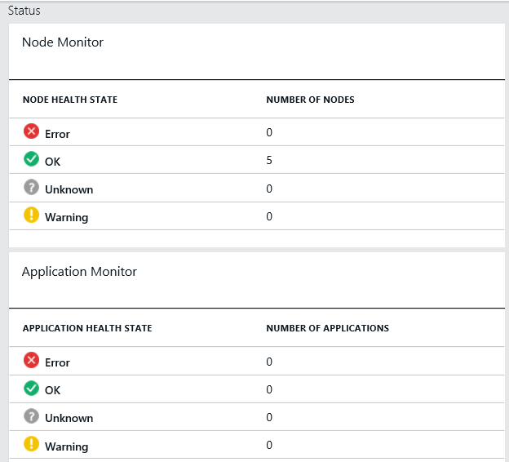
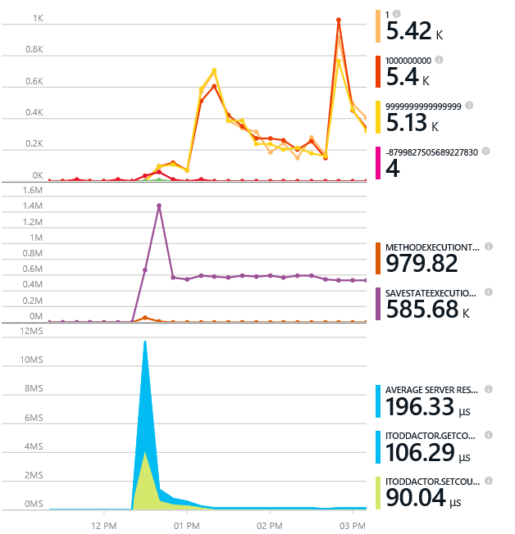
Monitoring your Services
Health status monitoring
Built-in health status for cluster and services
Flexible and extensible health store for custom app health reporting
Allows continuous monitoring for real-time alerting on problems in production
Performance and stress response
Rich built-in metrics for Actors and Services programming models
Easy to add custom application performance metrics
Notes:
*skip if tight on time*
Monitoring is a complex topic with as many solutions as there are applications. And for the most part, the solution is unique to an organization. So we’ll only briefly cover this today.
*click* Service Fabric features built-in health monitoring for both the cluster and services. You can add your own customer reporting values to this store which is part of the fabric system services and as such, available as long as the cluster is up and running. Giving you a continuous near real-time alerting to changes in the cluster or applications deployed with it. You can see some of these values in the cluster portal and the Azure management portal. Most recently, in Azure this has been integrated with the Service Fabric Analytics feature of Operations Management Suite.
*click* Its these same health metrics that are used by the Cluster Management Service when the cluster is rebalanced. As such, they aren’t just simple health status or diagnostics, but also key performance metrics. A model that’s easily extended to add your own custom application metrics. Great for measuring factors like end to end operation latency.
More Info:
Health Monitoring: https://azure.microsoft.com/en-us/documentation/articles/service-fabric-health-introduction/
OMS Integration: https://azure.microsoft.com/en-us/documentation/articles/log-analytics-service-fabric/#configure-oms-to-collect-and-view-service-fabric-logs

Slide 29
Diagnostics and Troubleshooting
Event Tracing for Windows
Fast Industry Standard Logging Technology
Works across environments. Same tracing code runs on devbox and also on production clusters on Azure.
Easy to add and system appends all the needed metadata such as node, app, service, and partition.
Choice of Tools
Visual Studio Diagnostics or Windows Events Viewer
Windows Azure Diagnostics + Operational Insights
Easy to plug in your preferred tools: Kibana, Elasticsearch and more
Event Tracing for Windows
Bring your favorite Java logging framework
Redirect output to handlers provided by the Service Fabric framework
Notes:
*skip if tight on time*
Performance and Health monitoring will tell you when there’s an problem, but its also important to know what was causing the problem. And Service Fabric helps meet that need to providing a selection of tools to capture information about your application code. There’s several techniques available but I wanted to talk about Application Tracing.
*click* Service Fabric support customer applicaton tracing based on ETW, Event Tracing for Windows. Its fast, and works both locally and in “real world” clusters. Its also the same approach used inside of Service Fabric itself. It can be added to an existing application and Service Fabric appends helpful meta data from the cluster to assist in your troubleshooting efforts.
*click* These traces can be viewed via different tools and even exported to external systems like Azure Diagnostics, Kibana, Elasticsearch, and more.
*click* Now we can’t forget that Linux is also a supported platform for Service Fabric. And ETW won’t do you much good there. So fortunately you can bring your favorite Java logging framework along. Just redirect its output to the handlers provided by the Service Fabric framework.
More Info:
Logging in Windows: https://azure.microsoft.com/en-us/documentation/articles/service-fabric-diagnostics-how-to-monitor-and-diagnose-services-locally/
Logging on Linux: https://azure.microsoft.com/en-us/documentation/articles/service-fabric-diagnostics-how-to-monitor-and-diagnose-services-locally-linux/
Distributed Tracing for Service Fabric with App Insights: https://blogs.msdn.microsoft.com/cloud_solution_architect/2016/10/06/distributed-tracing-in-service-fabric-using-application-insights/

Slide 30

A Platform for Microservices is not Free
Problems to Solve
Service Availability
Resource Allocation
State Management
Versioning
Independently upgradable services / data
Roll backs
You provide the design & code
You can still write monolithic applications and do bad things!
Notes:
So there you have it. Service Fabric in 60 minutes (or less). As you can hopefully tell by the amount of topics we had to differ for another day, there’s A LOT more to Service Fabric then we covered today. Entire books worth of content already exist and I’m certain more will be written. So let me leave you with this thought…
Service Fabric is not a silver bullet that will solve all your problems. Its like trying to build a house and buying a stack of lumber. If you want a door, you’ll have to build it. There’s very little “plug and play here”. Your solution will need to solve some very real problems such as ensuring they can handle being rebalanced and remaining available, that versioning it dealt with. And upgrades and rollbacks (especially when you’re upgrade stateful data).
You have to bring the code and build your own services. This means you can still build a monolithic application and do all the same bad things we’ve all enjoyed doing for years!

Slide 31
Interested in More?
https://aka.ms/brent-servicefabric-intro
Content © Microsoft
Notes:
Too many learning materials to list here. I’ve put some of my favorites, along with a link to his presentation and some related materials up on GitHub.. Enjoy and check back for updates as things continue to mature.

Slide 32

Thank you!
https://aka.ms/brent-servicefabric-intro
Brent Stineman
DX/TED, Azure Specialist, Cloud Evangelist
Email: brestin@microsoft.com
Twitter: @brentcodemonkey
Web: http://brentdacodemonkey.wordpress.com
→
Creating quality bugs since 1992!
Notes:
Image Courtesy of Brent.
Purple dye all over his face is courtesy of his daughter

Slide 33
























PLATINUM
thank you dev up Conference 2016 Sponsors !
GOLD
SILVER

Slide 34
dev up Conference 2016 Attendee Party
Ryse Nightclub
October 21st Friday 5:15 – 10:15
Food, Drinks, Games, and Fun!

